Slide 1
Enterprise Project Server 2016 Project Online
Hari Thapliyal

Slide 2
Portfolio Management

Slide 3
Business Drivers
Increase Product Awareness between 13-18 years old
Reduction of Supporting call waiting time
Reduce employee attrition rate
Increase sales volume by selling in new market
Reducing the cost of goods
Increase revenue per client

Slide 4
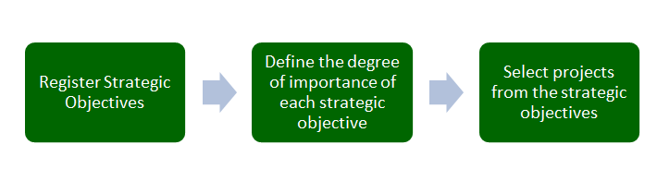

Slide 5
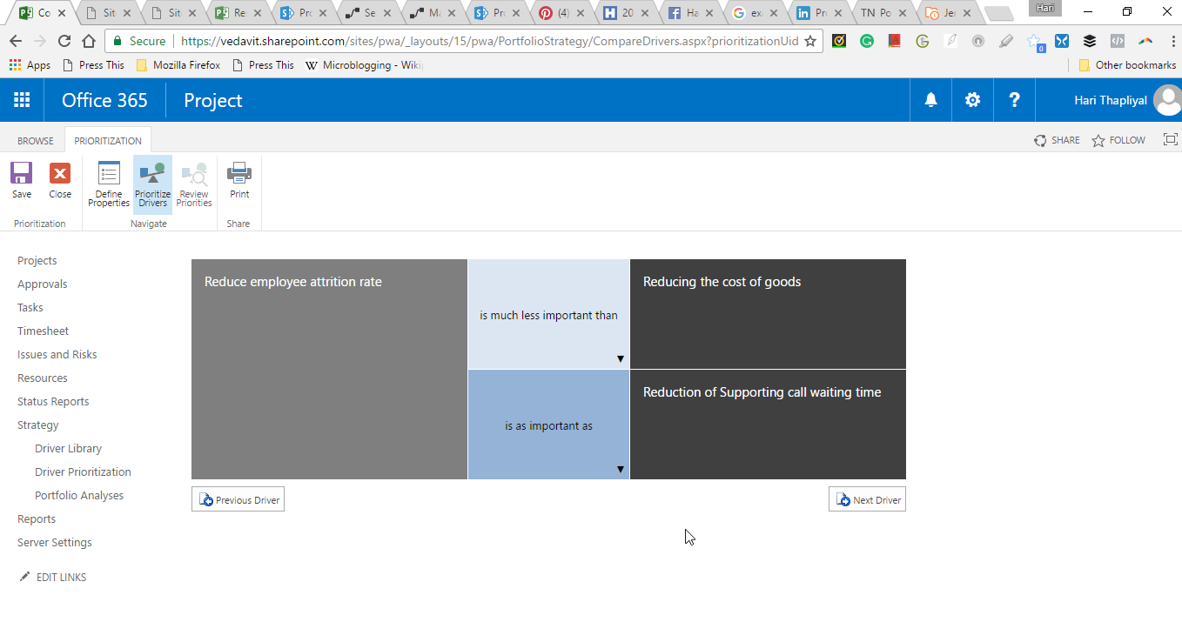
Driver Prioritization

Slide 7
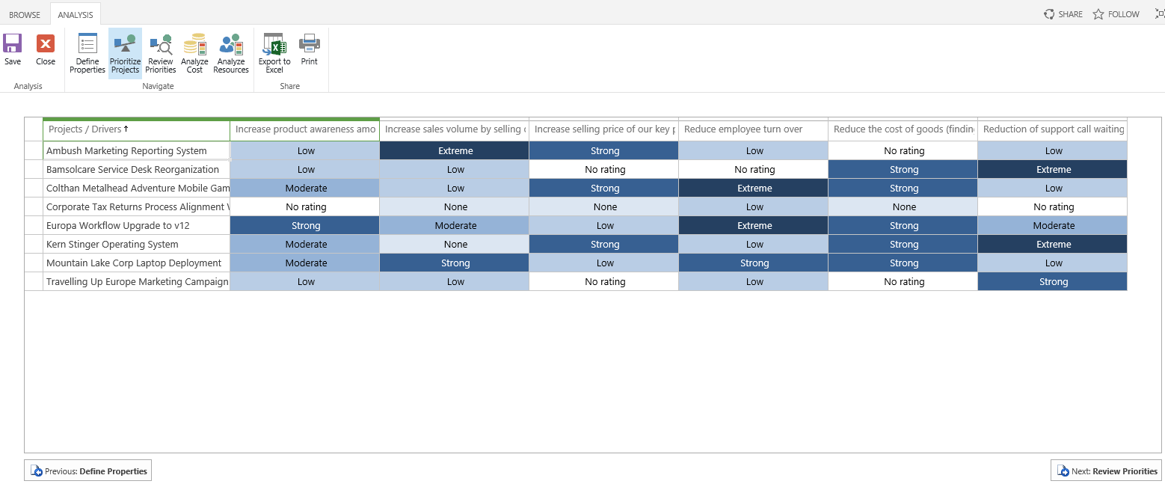

Slide 8
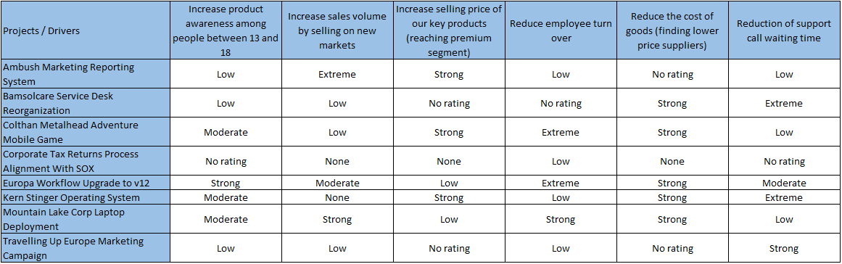

Slide 9
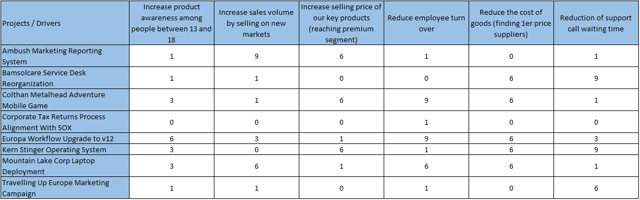

Slide 10



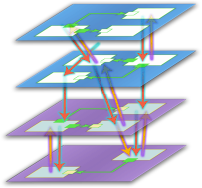







The Enterprise Project Management Solution
Four typical phases of demand management lifecycle
Enterprise Project Management
Create
Select
Plan
Manage
Demand Management
Portfolio Selection
Work Planning
Collaboration & Reporting

Slide 11
Demand Management Concepts
Enterprise Project Types
Workflows
Stages/Phases
Project Detail Pages
SharePoint/Custom Web-parts
Enterprise Custom Fields

Slide 12
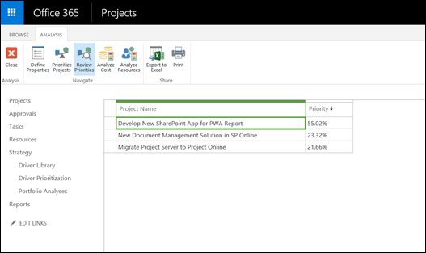

Slide 13
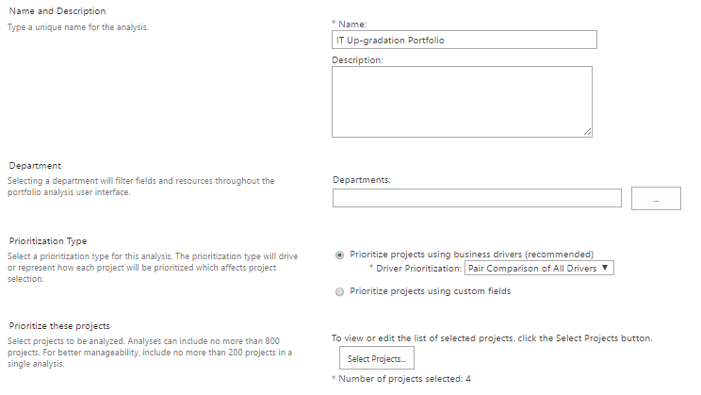
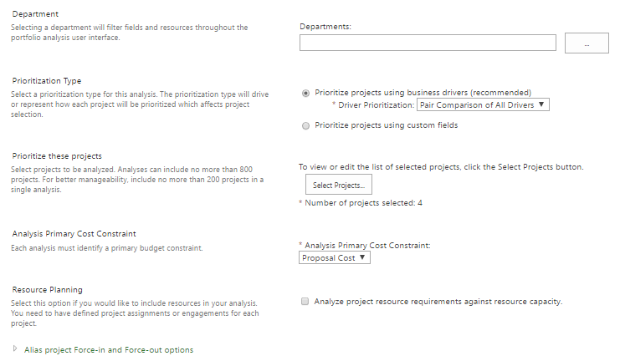
Portfolio Analysis
1
2

Slide 14
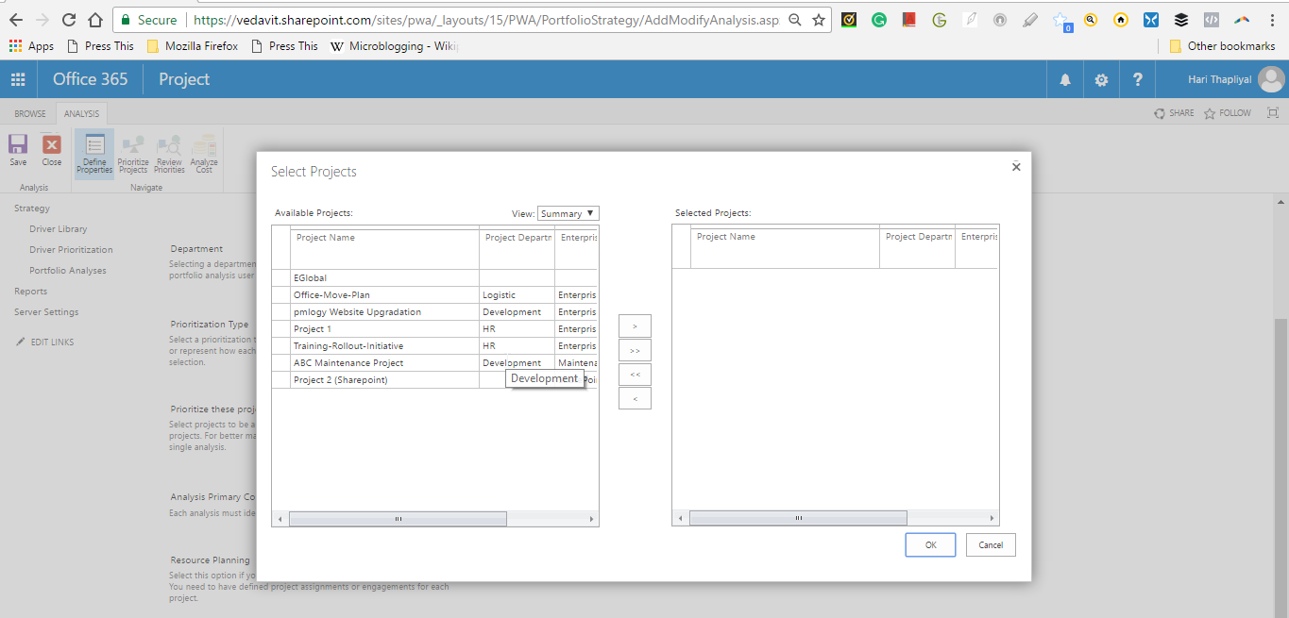
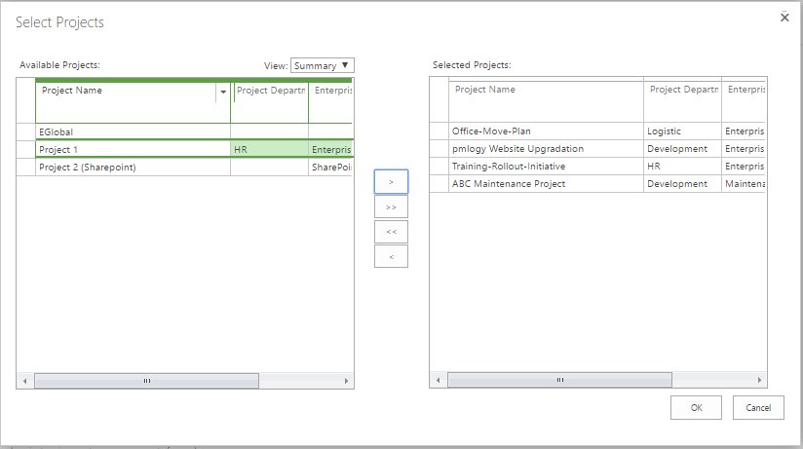
Portfolio Analysis Cont..

Slide 15
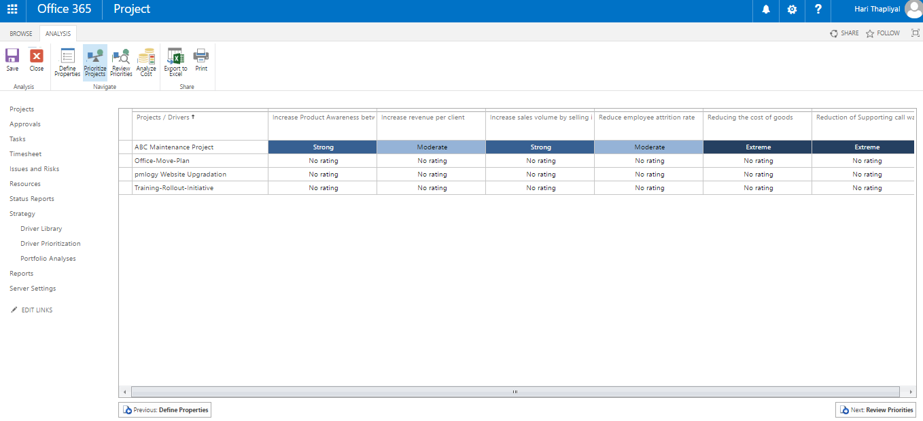
Portfolio Analysis Cont..

Slide 16
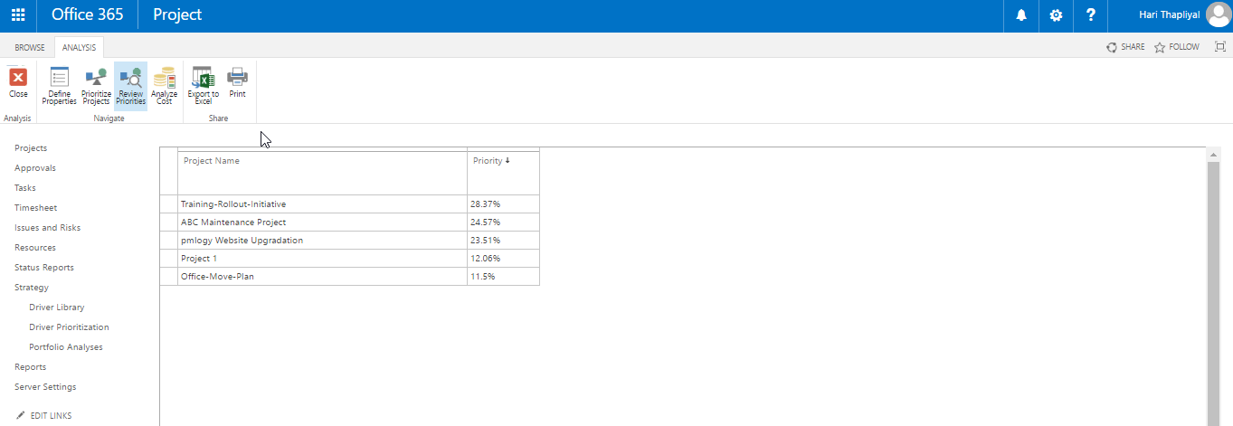
Portfolio Analysis Cont..

Slide 17
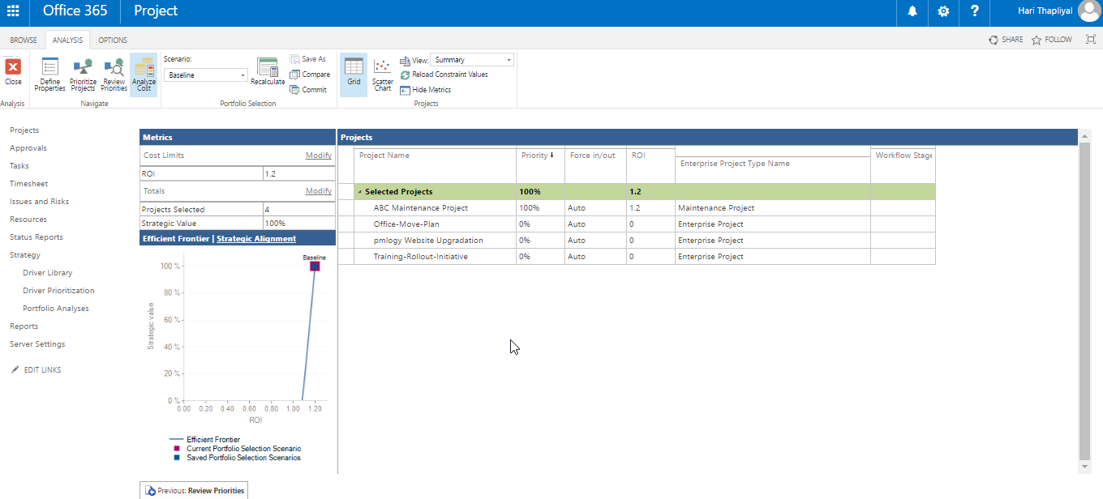
Portfolio Analysis Cont..

Slide 18
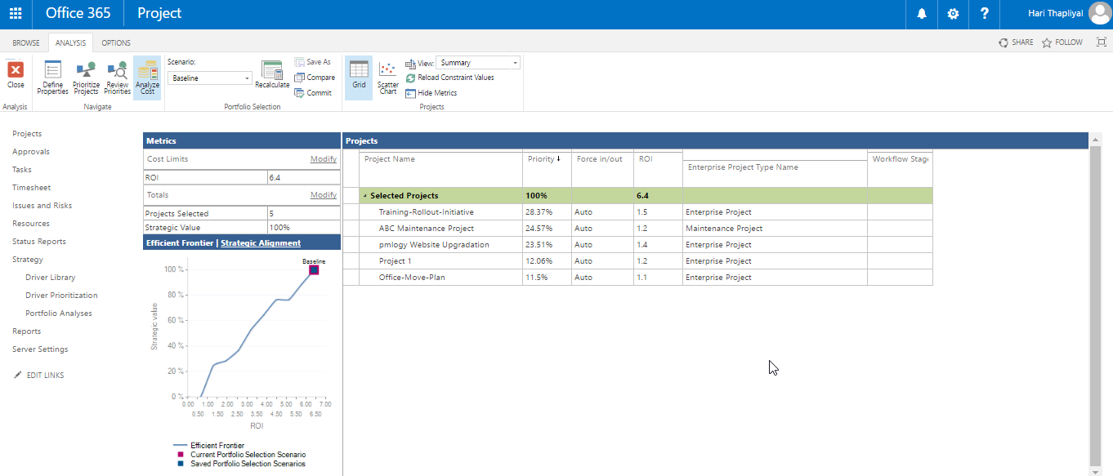
13-EPM-2016 & Project Online - Portfolio - PowerPoint

Slide 19
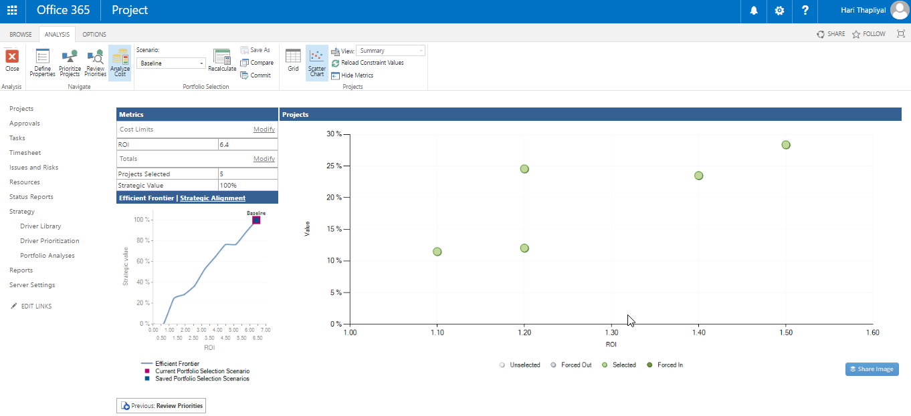
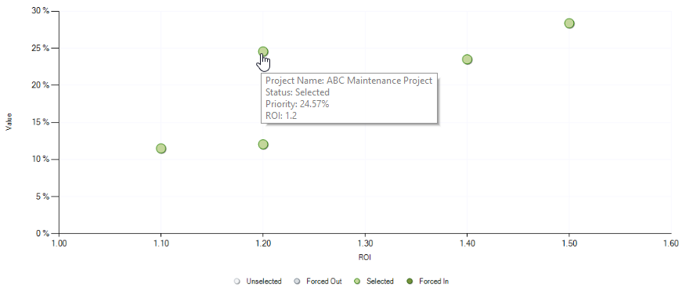
13-EPM-2016 & Project Online - Portfolio - PowerPoint

